Slide 1
Automated segmentation of red blood cells
Comparison between contour detection and deep learning approaches

Slide 2
Compared approaches & Methodology
Approach 1 : Contour detection
Use of Watershed algorithm.
The watershed is a classical algorithm used for segmentation, that is, for separating different objects in an image.
Approach 2 : Deep learning
Use of a trained YOLO model.
YOLO is real-time object detection system based on neural network.
Methodology
Comparison of these two approaches based on 18 blood samples.

Slide 3
Results
 | Contour detection | Deep learning
# of compared blood samples | 18 | 18
# of segmented red blood cells | 21 243 | 14 337
# of positive deviation vs. other approach | 18 (100%) | -
Average pourcentage of positive deviation vs. other approach | + 64% | -
Maximum positive deviation value vs. other approach | + 880 | -
Execution time (in seconds) | 16-18 | 10-12

Slide 4
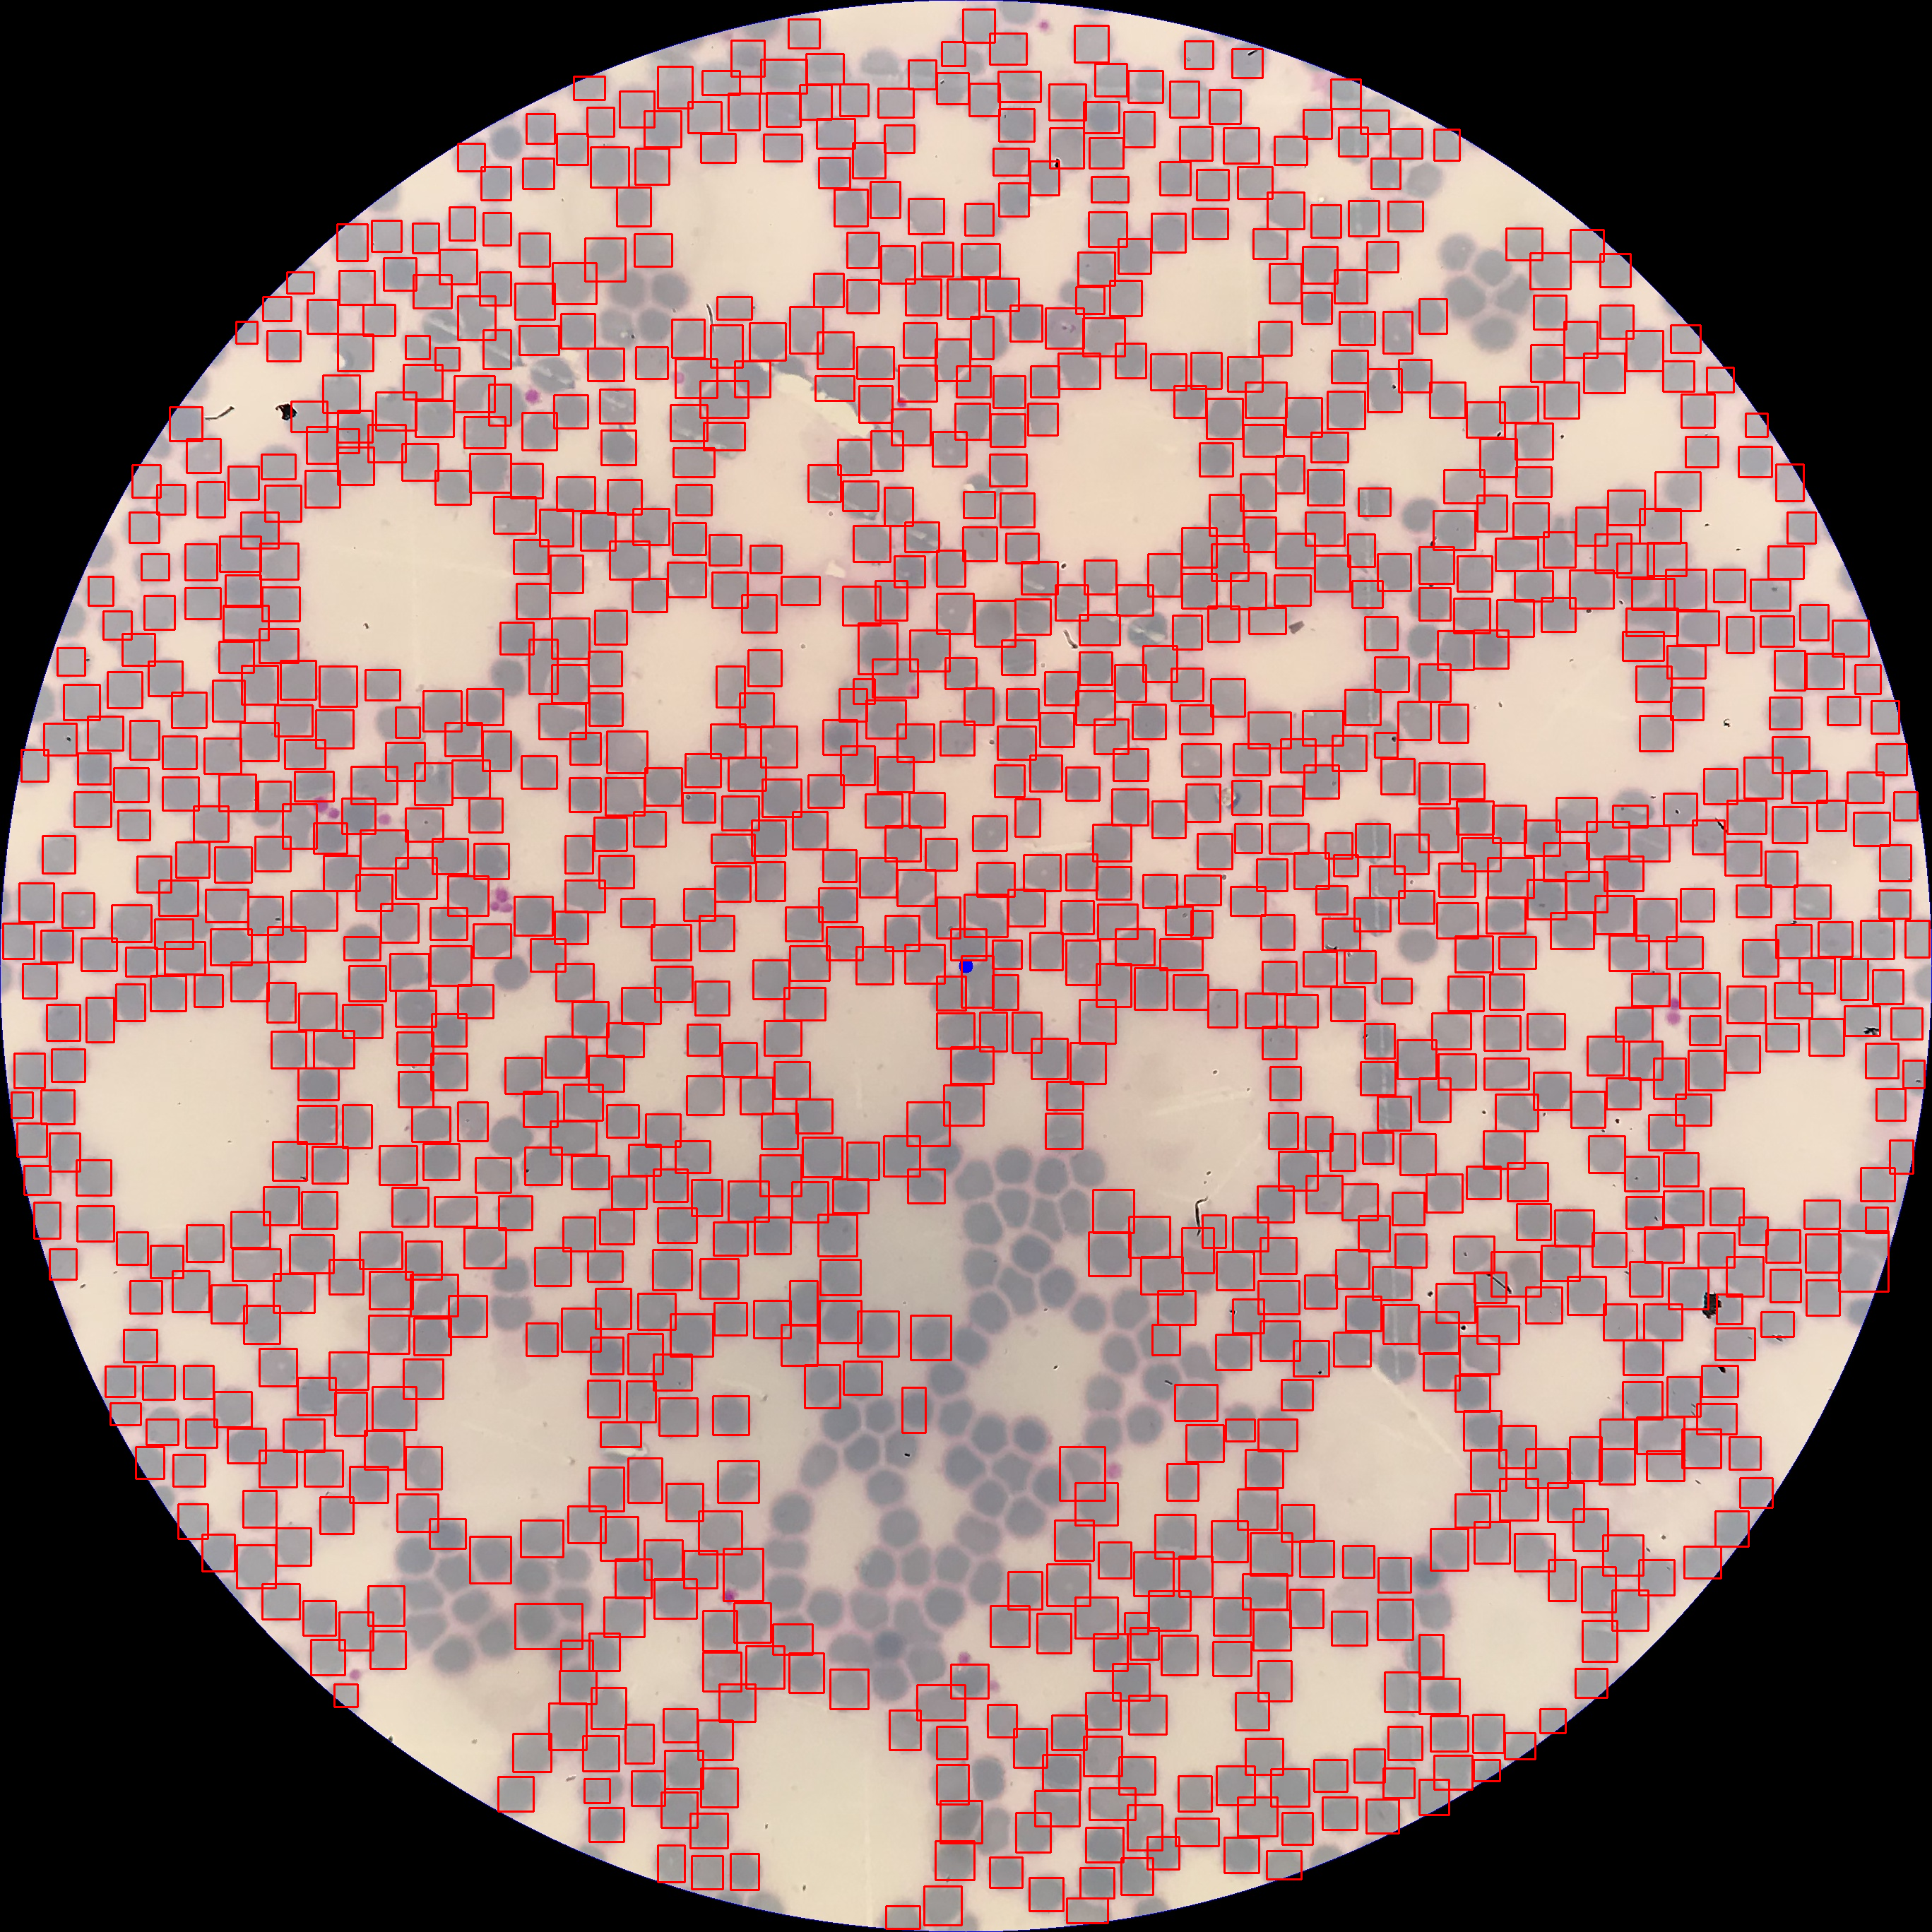
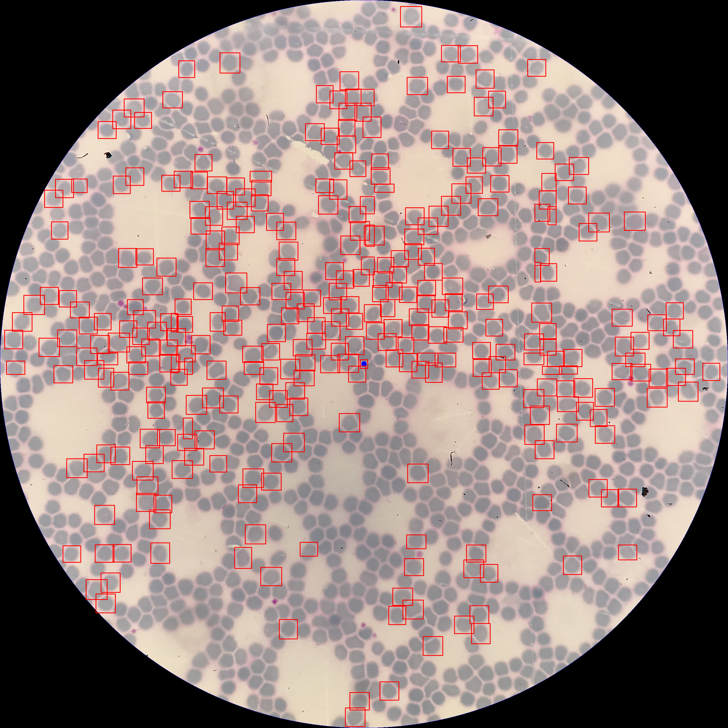
Example 1 : Maximum positive deviation for contour detection approach
Contour detection | Deep learning
1213 | 333

Slide 5
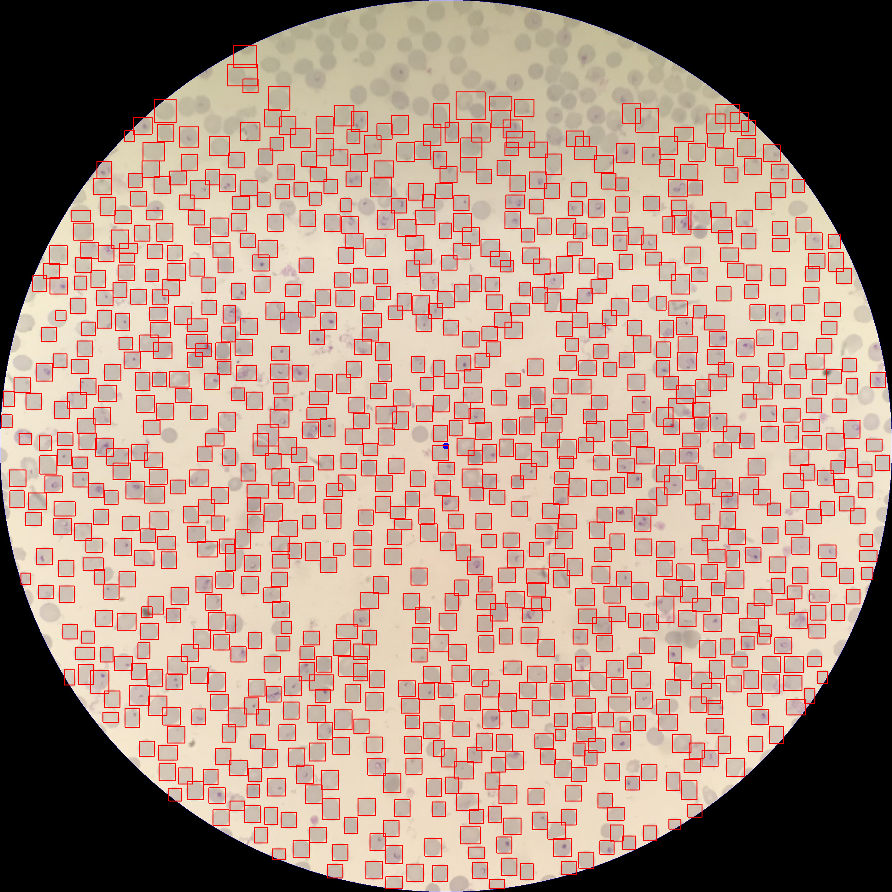
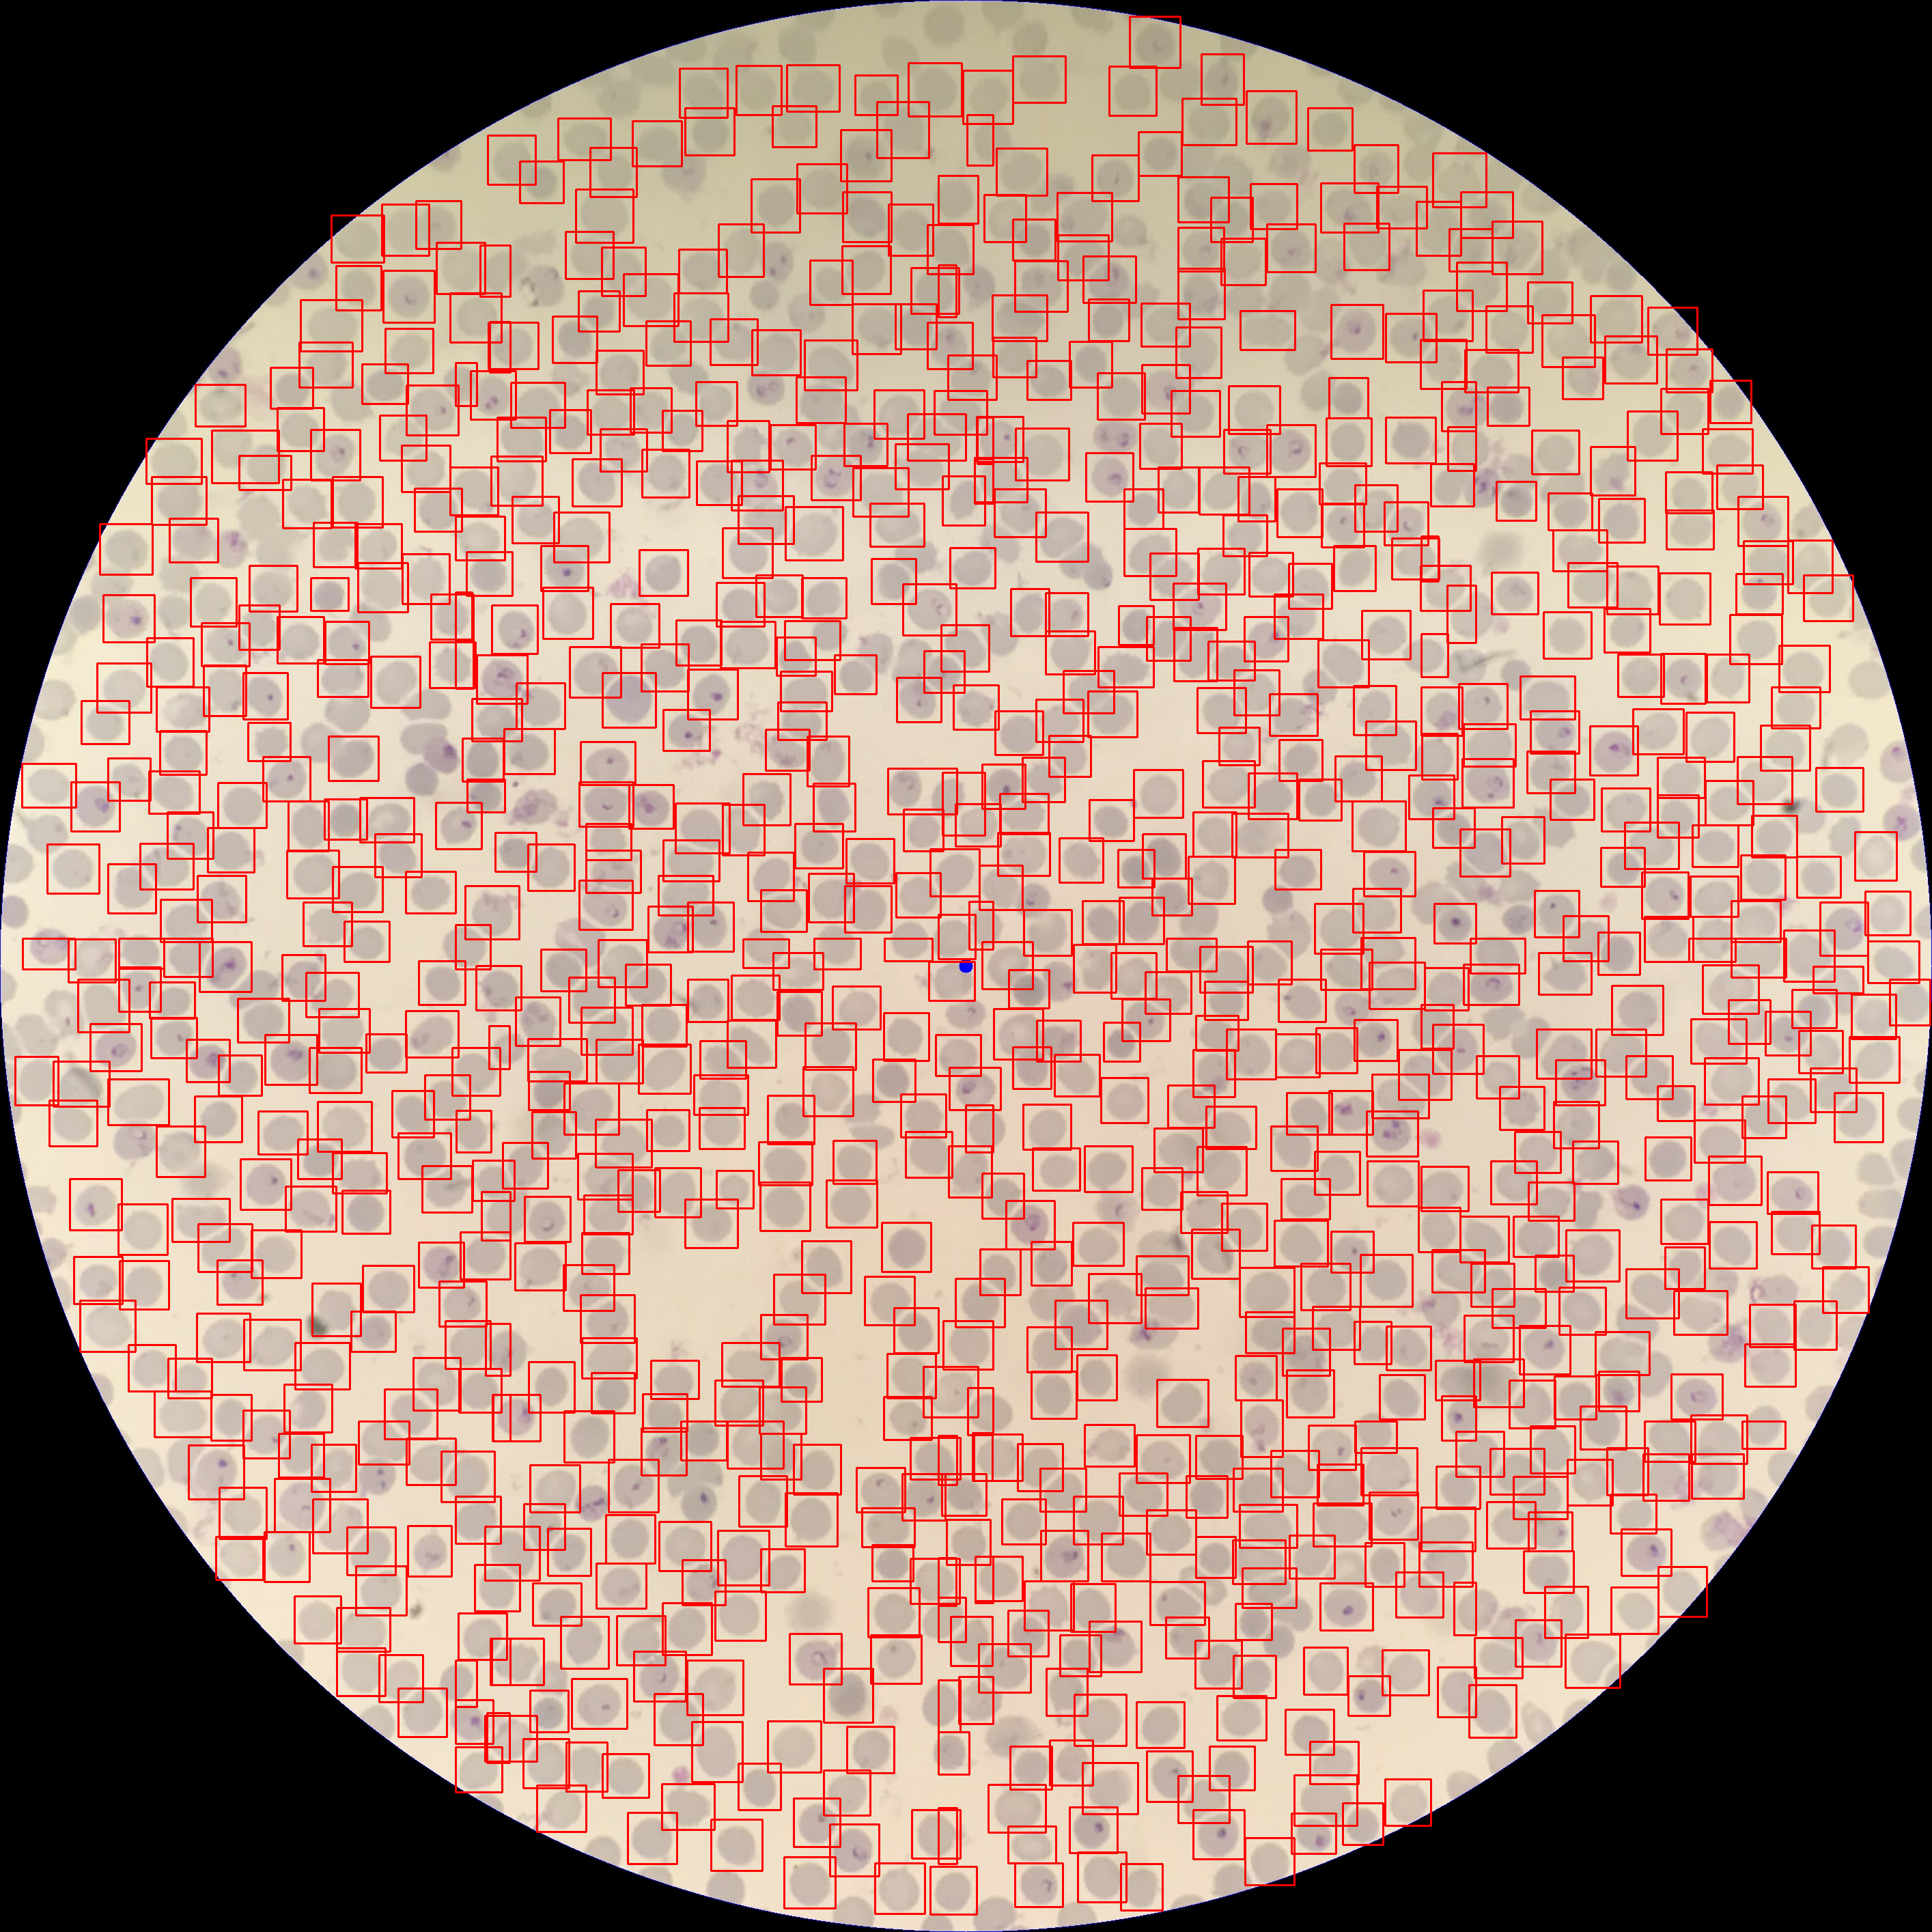
Example 2 : Shadow sensitivity of contour detection approach
Contour detection | Deep learning
1110 | 936

Slide 6
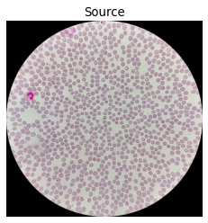
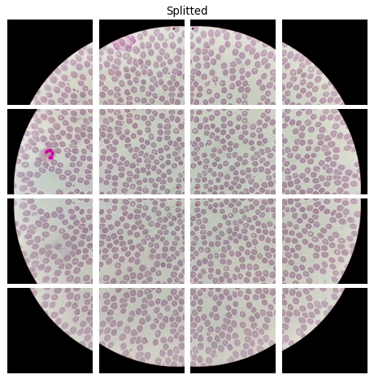
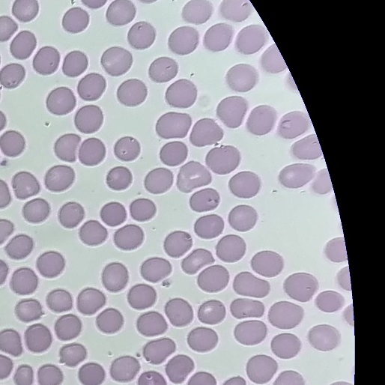
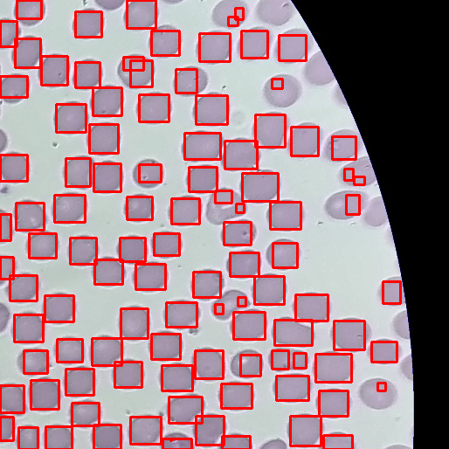
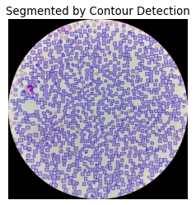
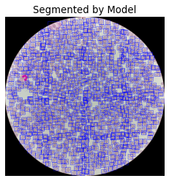
Detailed segmentation method
Step 1 : 4x4 split of the image
Step 2 : segmentation of RBCs within each splitted square
Step 3 : merge of splitted squares

Slide 7
Results by image
 | Contour detection | Deep learning | Deviation
Image 1 | 1110 | 936 | + 19%
Image 2 | 1027 | 1007 | + 2%
Image 3 | 1428 | 956 | + 49%
Image 4 | 1113 | 588 | + 89%
Image 5 | 1089 | 871 | + 25%
Image 6 | 1153 | 844 | + 37%
Image 7 | 1050 | 783 | + 34%
Image 8 | 1302 | 421 | + 209%
Image 9 | 1659 | 825 | + 101%
Image 10 | 1177 | 855 | + 38%
Image 11 | 1389 | 624 | + 123%
Image 12 | 1112 | 1010 | + 10%
Image 13 | 1157 | 844 | + 37%
Image 14 | 781 | 577 | + 35%
Image 15 | 1213 | 333 | + 264%
Image 16 | 1003 | 700 | + 43%
Image 17 | 1035 | 966 | + 7%
Image 18 | 1445 | 1197 | + 21%

Slide 8
Git repository
git clone https://github.com/casusorez/plasmodium.git

